Slide 1


Talent Management Case Study
DS 6306 – Project Two
Jason Burk

Slide 2
Attrition 16.1%
Current company attrition is based on 140 employees leaving out of 870 over the last year. WHY?
Recent tour of the BMW Spartanburg, SC manufacturing plant told a story that their attrition was a low 3% (11/26/2019)

Slide 3
Analysis of the Data
870 data records with 36 attributes contained no missing data
Several attributes contained all the same values for each employee and did were not used
Employee Count (all contained 1)
Over 18 (all contained Y)
Standard Hours (all contained 80)

Slide 4
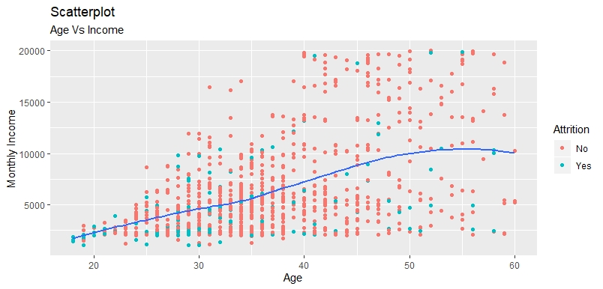
Age vs Monthly Income
Notes:
Do older people make more money than younger people within the company?

Slide 5
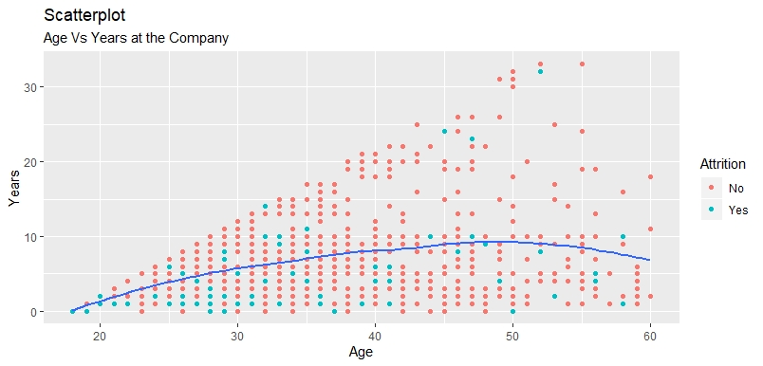
Age vs Years with the Company
Notes:
What about age vs years with the company?

Slide 6
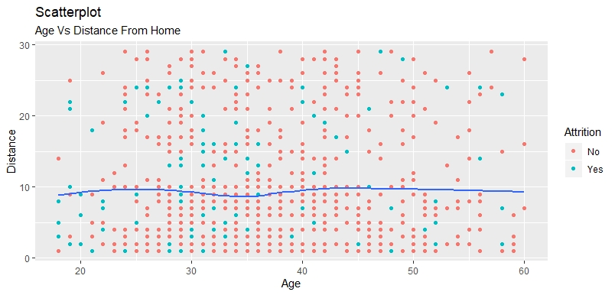
Age vs Distance from Home
Notes:
Is there a relationship between Age and distance from home?

Slide 7
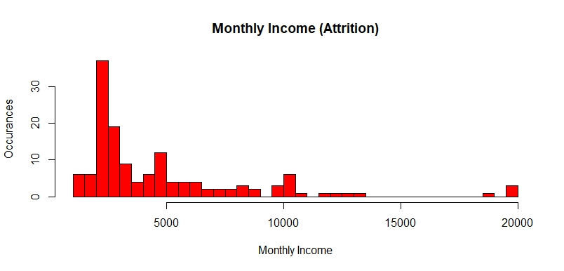
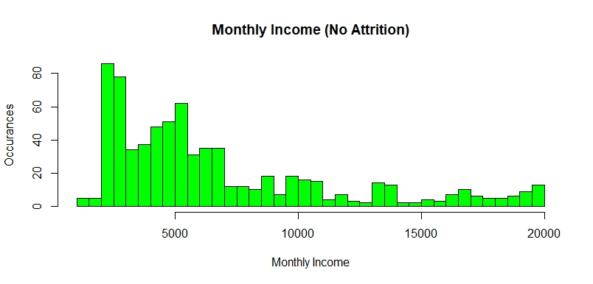
Monthly Income Comparison

Slide 8
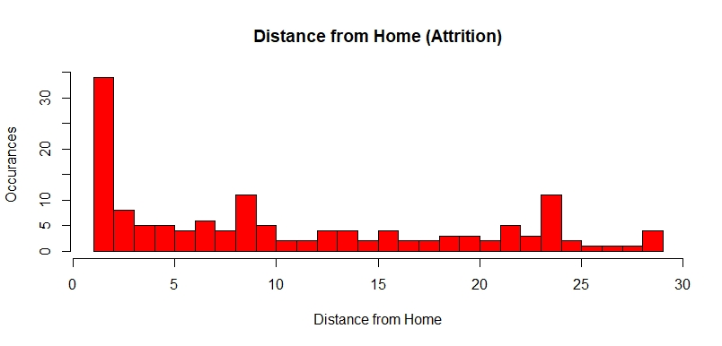
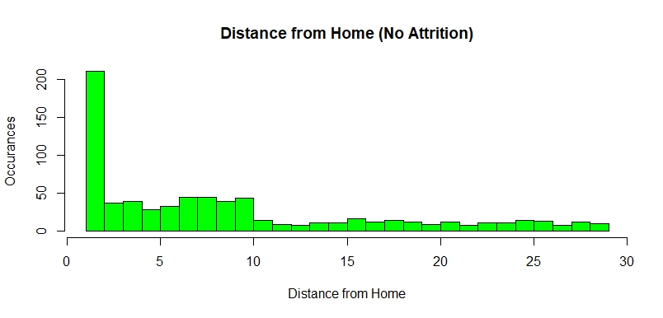
Distance From Home

Slide 9
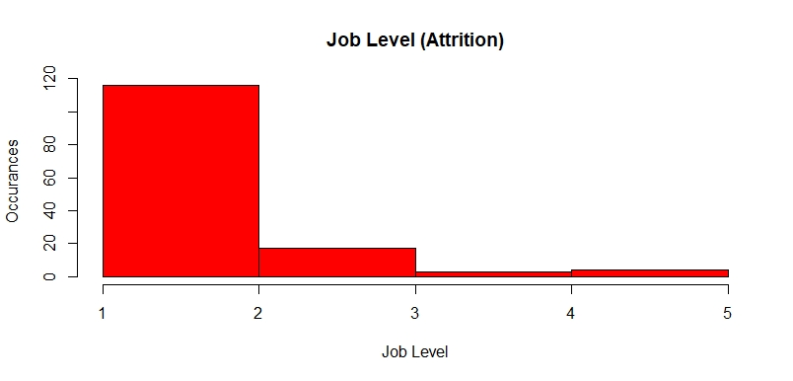
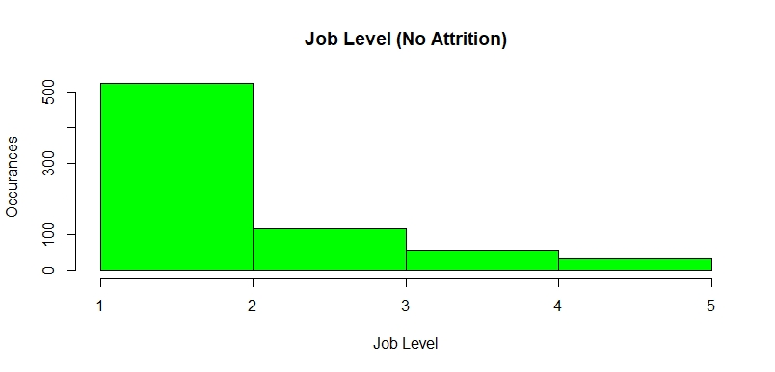
Job Level

Slide 10
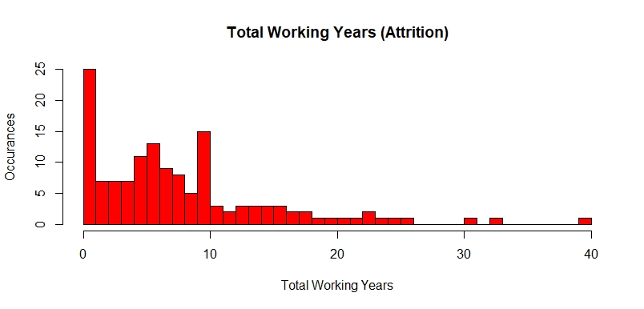
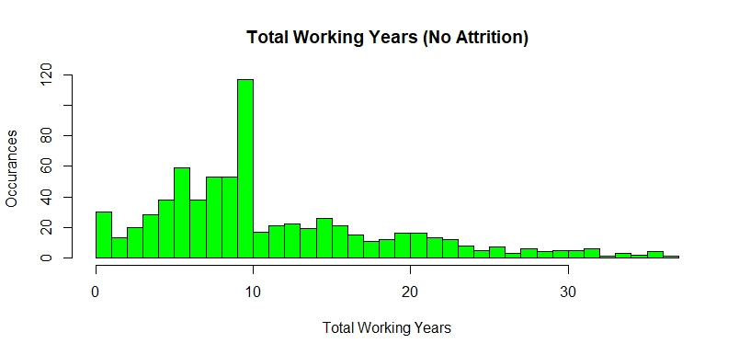
Total Working Years

Slide 11
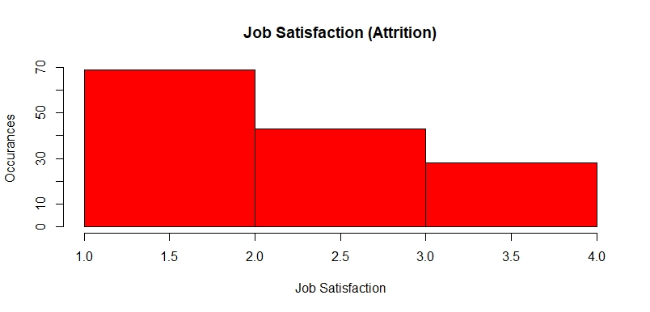
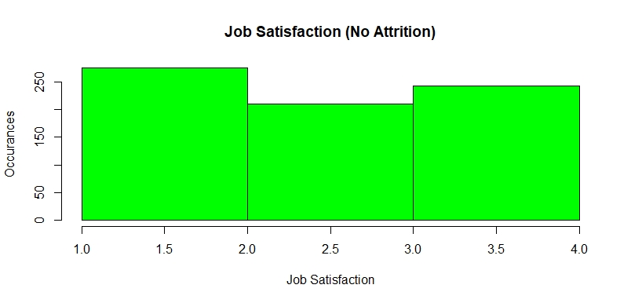
Job Satisfaction

Slide 12
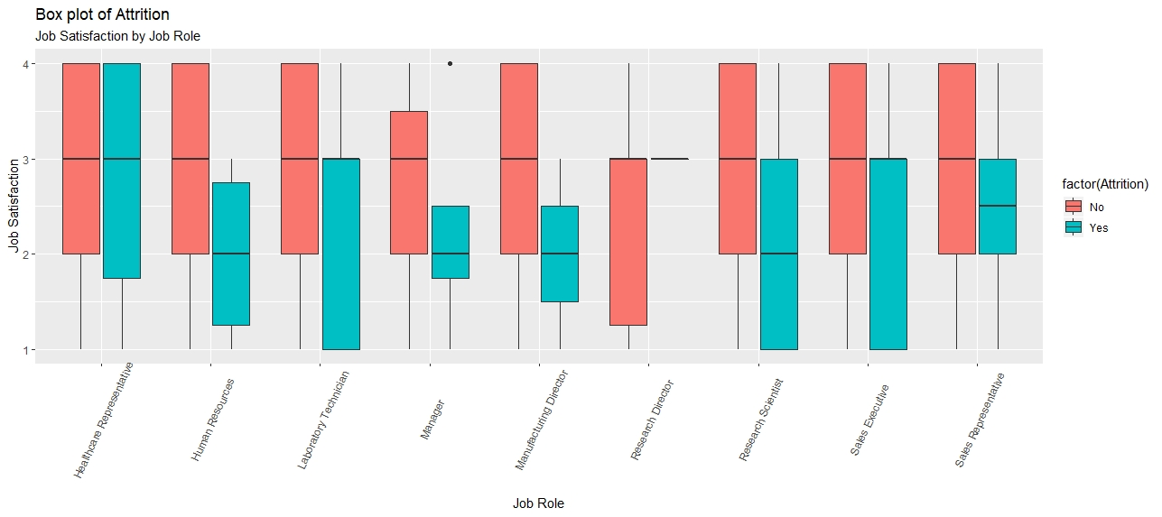
Job Satisfaction by Role
Notes:
Green means they have left (Attrition = yes)

Slide 13
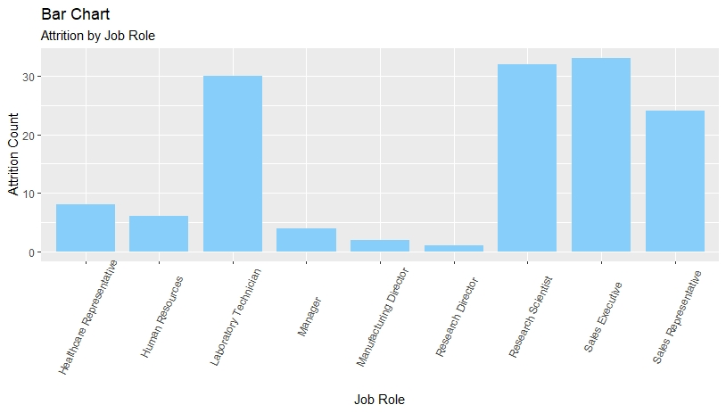
Number Leaving by Role
10.5%
22.2%
19.6%
7.8%
2.3%
2.0%
18.6%
16.5%
45.3%

Slide 14
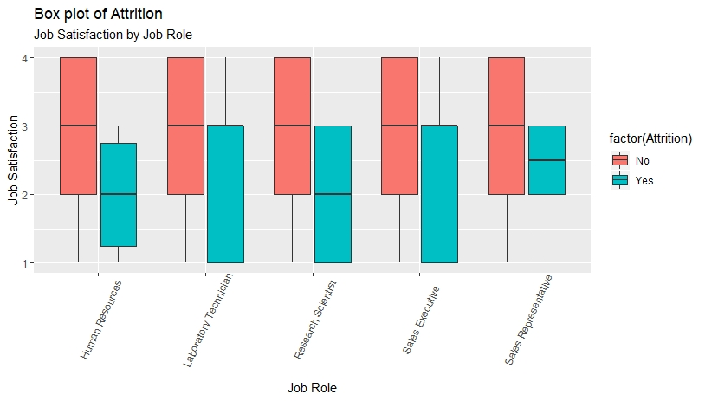
Job Satisfaction by Role

Slide 15
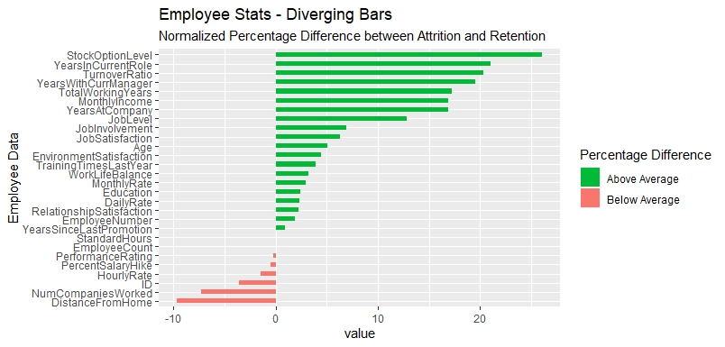
Top Three Factors
Stock Options Level
Levels from 0 - 3
Years in Current Role
0 – 15 years for people who left
0 – 18 for those who remain
Turnover Ratio
A derived ratio based on an employees total working years divided by the number of companies they have worked for. Example: 10 years total work / 5 companies = 2 years for each company

Slide 16
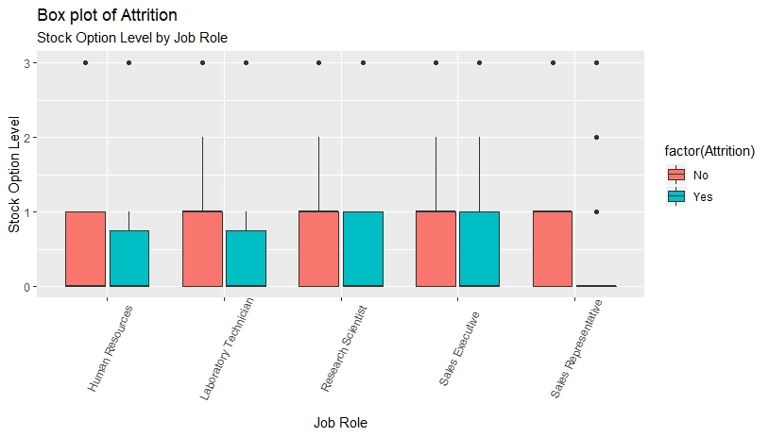
Stock Option Level for Job Roles

Slide 17
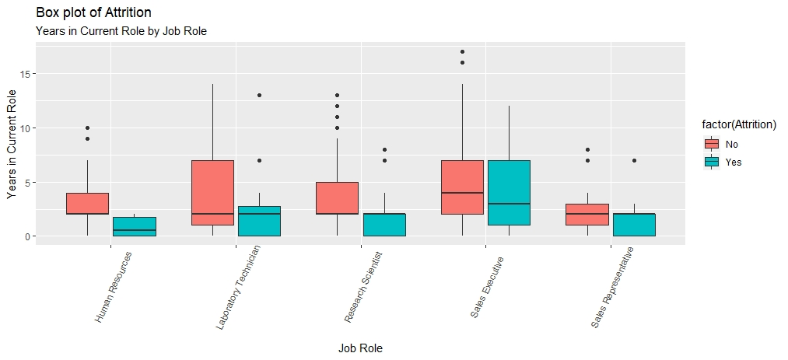
Years in Current Role for Job Roles

Slide 18
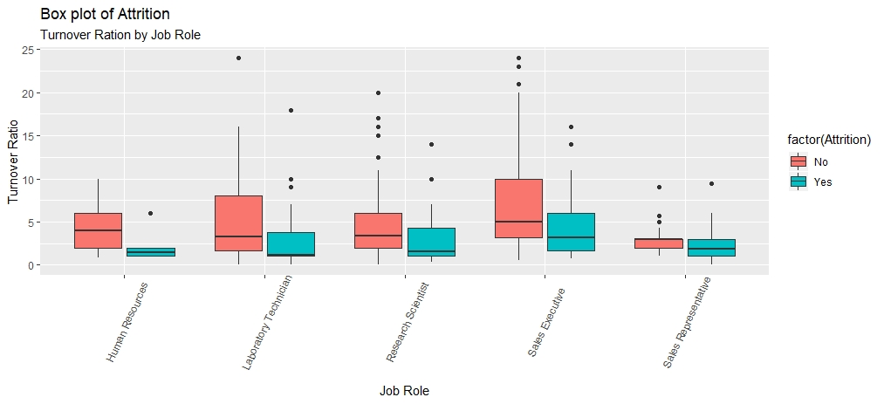
Turnover Ratio for Job Roles

Slide 19
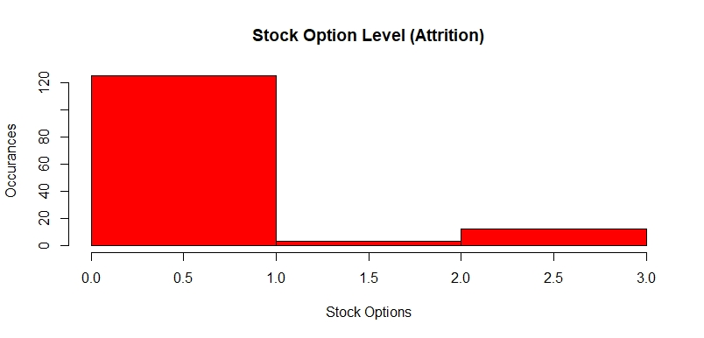
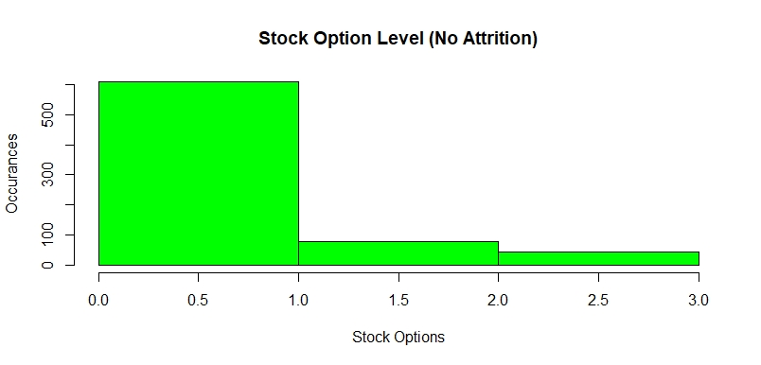
Stock Options
Stock Option Levels from 0 - 3

Slide 20
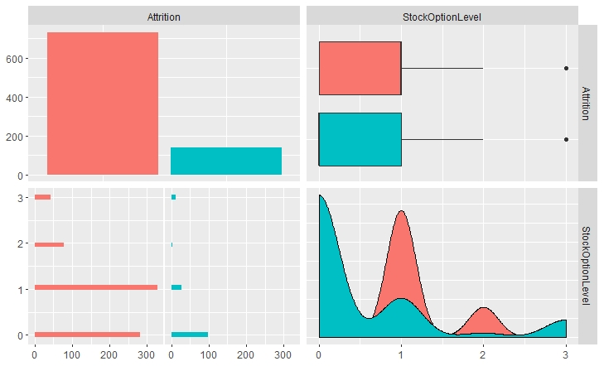
Top Three Attrition Factors Stock Options
*Green = Attrition
Higher values are better

Slide 21
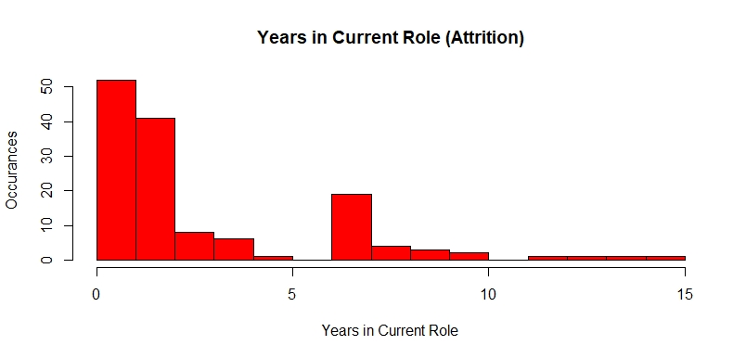
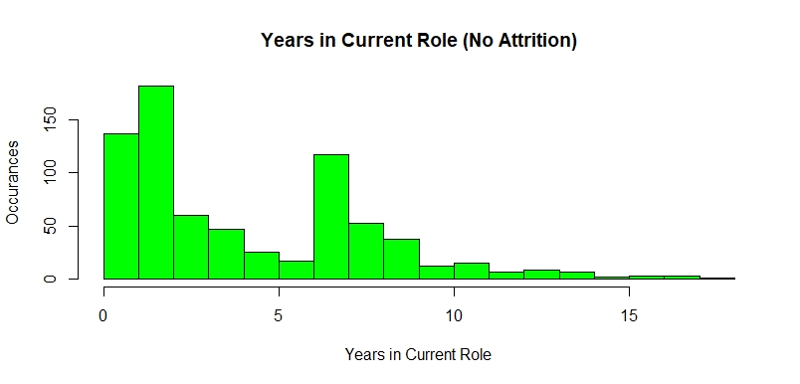
Years in Current Role
Years in Current Role range from 0 - 18

Slide 22
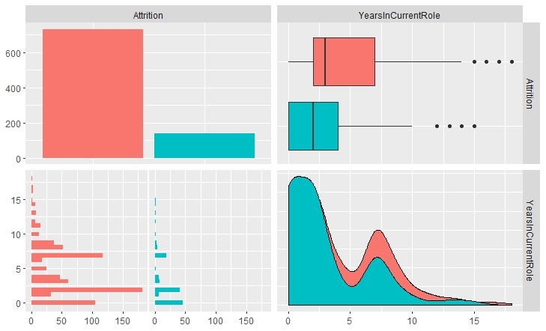
Top Three Attrition Factors Years in Current Role
*Green = Attrition
Higher values are better

Slide 23
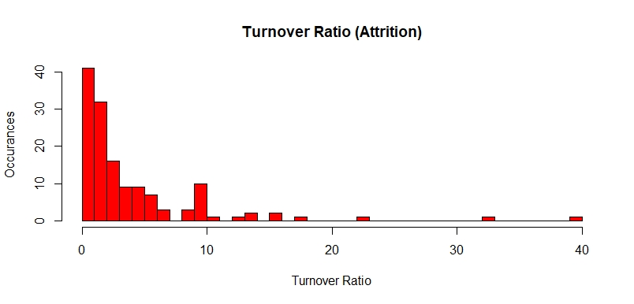
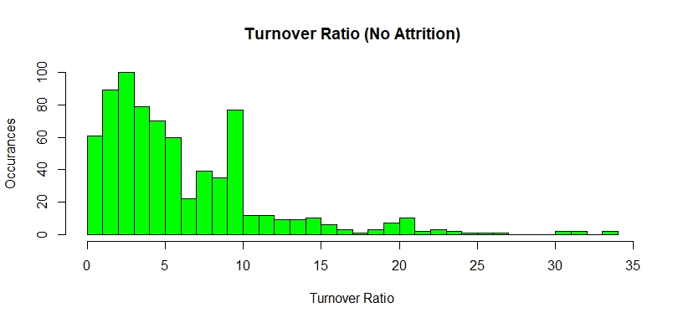
Turnover Ratio
Turnover Ratio ranges from 0 - 34

Slide 24
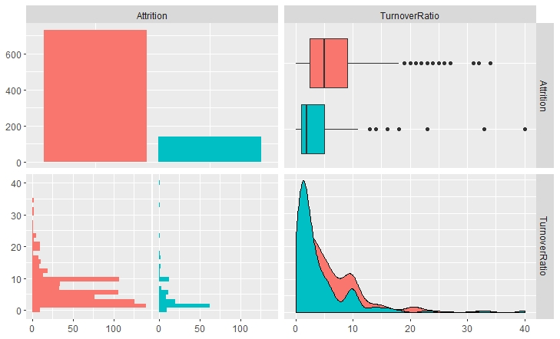
Top Three Attrition Factors Turnover Ratio
*Green = Attrition
Higher values are better
Notes:
A lower turnover ratio means that an employee is more susceptible to switching companies more frequently. Often done for perceived benefit by the employee.

Slide 25
Recommendations
Increase Job Satisfaction by:
Adding more Stock Option Levels for High Turnover Employee Job Roles
Reward Longevity within the Company and Inform Newer Employees – especially for High Turnover Employee Job Roles
Find ways to retain younger employees that have changed jobs frequently. Or hire new employees that do not have a history of changing jobs frequently.

Slide 26

Thank you
Notes:
Thank you

Slide 27
Bonus Slides
Model Predictions for Attrition

Slide 28
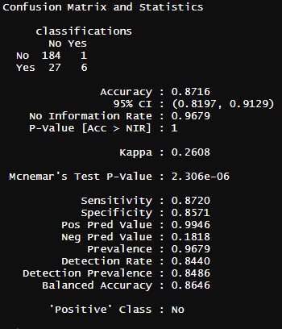
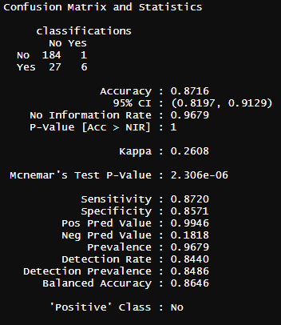
K-nn vs Naïve Bayes
K-nn
Naïve Bayes

Slide 29
K-nn

Slide 30
Naïve Bayes

